Slide 1
Coding Enigma
Kristen Cunningham and scott maxa

Slide 2
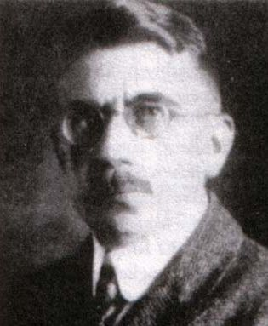
History
Enigma patented in 1918
Patented by Arthur Scherbius
First sold commercially to German banks and businesses
Extended machine used for WWII
Added the plugboard
Key sheets
Issued month by month
Indicated enigma set up instructions for each day that month
Closely guarded and printed in soluble ink

Slide 3
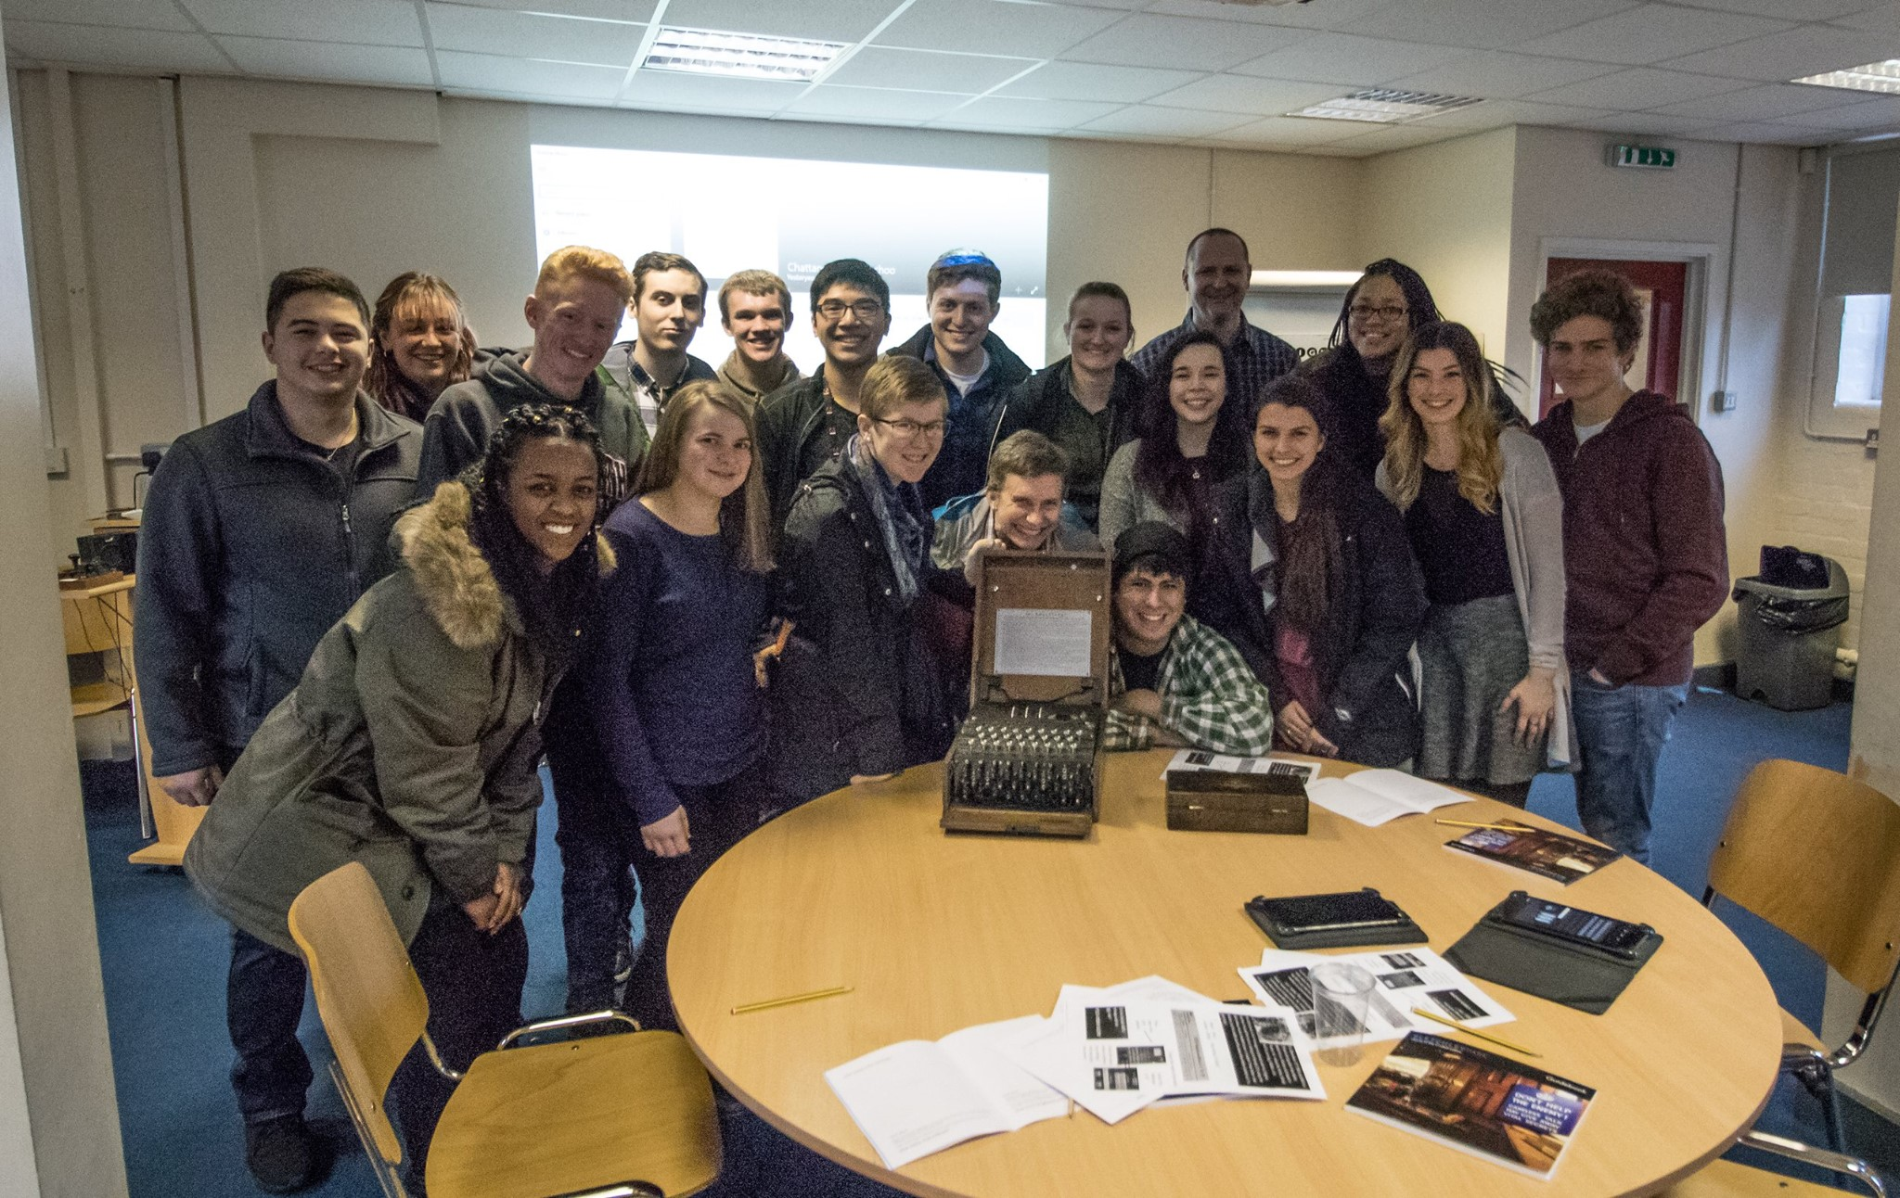
Breaking Enigma
Polish had various techniques for cracking enigma before WWII
Keyword clues in ciphertexts
Weather Report and Heil Hitler
German Girlfriends – “Cilli”
Swearwords
Alan Turing and the Bombe
Bombe reduced the number of possible combinations
Once broken, couldn’t use some of the information

Slide 4
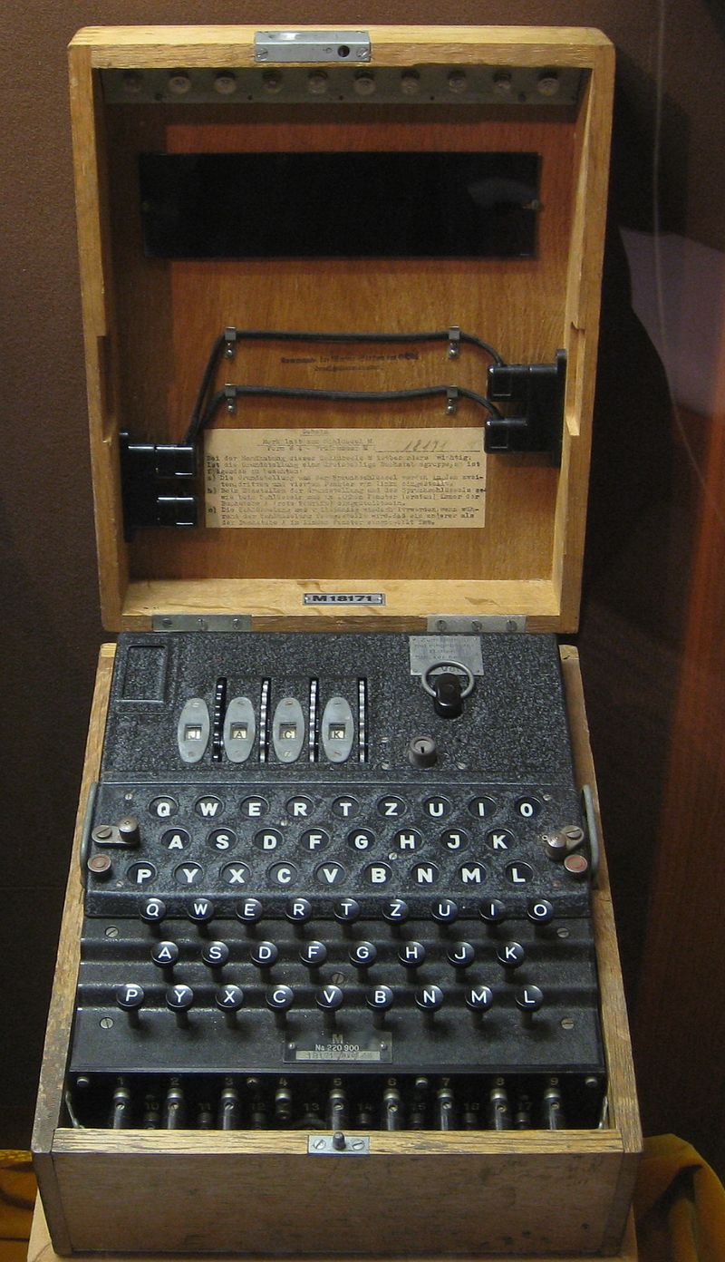
Navy Enigma
Navy general suspected code was broken
Navy created M4 enigma machine
February 1st 1942
M4 codenamed Shark, Triton
Allowed machine to have 4 rotors instead of three
Thin 4th rotor and thin reflector

Slide 5
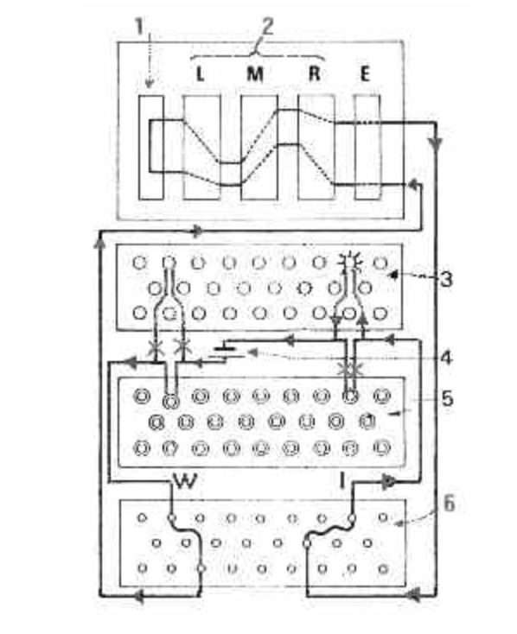
layout
Middle/Third Stage
Second Stage
Fourth Stage
First Stage
Last Stage

Slide 6

Inner Workings - Rotors
Each rotor had different wirings
Rotations
Fast rotor – each keyboard click
Medium rotor – every 26 clicks
Slow rotor – every 676 clicks
Eight Possible Rotors
Knock-out Effect

Slide 7
Inner Workings – Reflector and Plugboard
Plugboard
Additional 10 wirings
First and last step of the encryption
Reflectors
Middle stage of process
Multiple different reflector options
Vital flaw: Made cipher unable to be same letter as plaintext

Slide 8
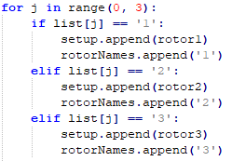
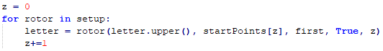

Implementation – choosing rotors!

Slide 9
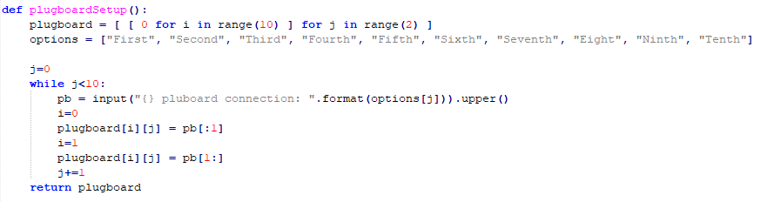
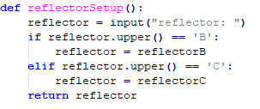
Implementation – Reflector and Plugboard

Slide 10
ACTIVITY!!!
Rotors
Reflector
Plugboard

Slide 11
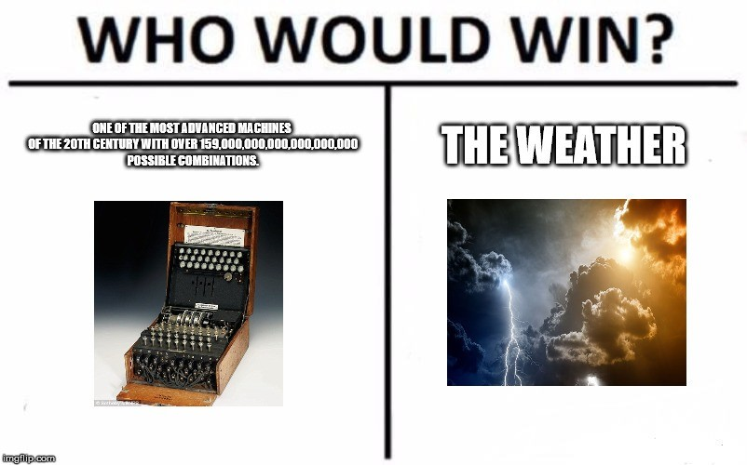
Demo

Slide 12
TRIVIA

Slide 13
Q1
How many different rotors are there?
8

Slide 14
Q2
How many possible plugboard wires are there?
10

Slide 15
Q3
What were the two codenames for M4?
Shark and Triton

Slide 16
Q4
Which step of the process contained the vital flaw?
Middle Stage - Reflector

Slide 17
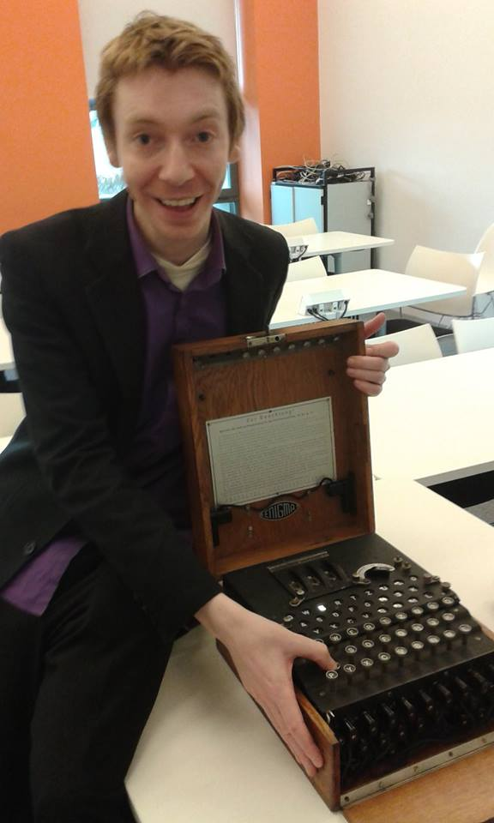

Q5
What is Nate’s favorite youtube channel?

Slide 18
Q6
What were three of the German key phrases exploited by the codebreakers?
Heil Hitler
Swearwords
Girlfriends Names – Cilli
The Weather Report

Slide 19
Q7
What was the vital flaw in the design of the enigma machine?
Letter can’t be itself

Slide 20
Questions?

